Slide 1
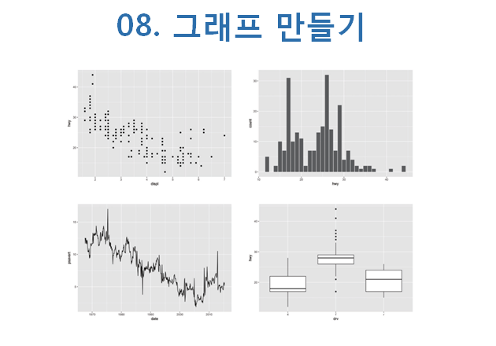

Slide 2
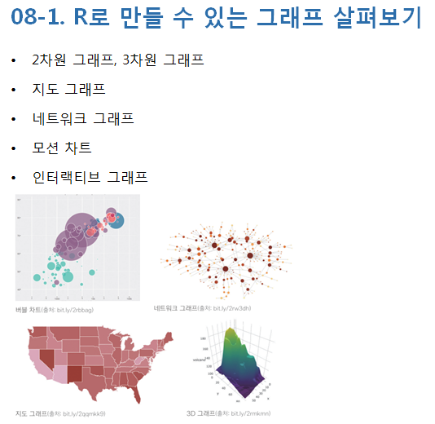

Slide 3
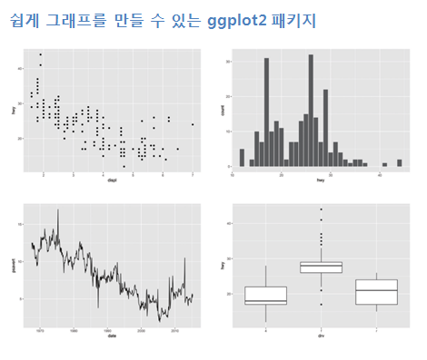

Slide 4
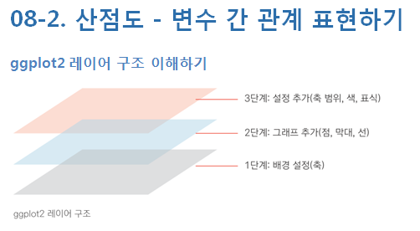
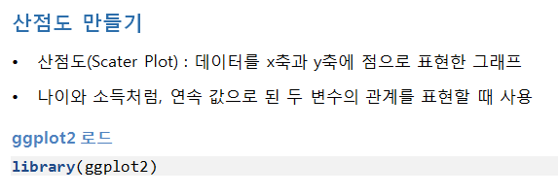

Slide 5
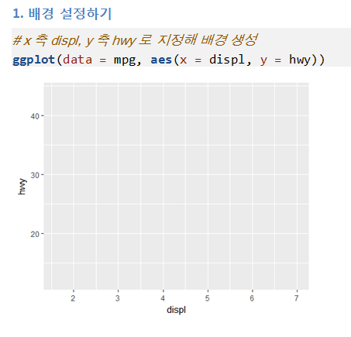

Slide 6
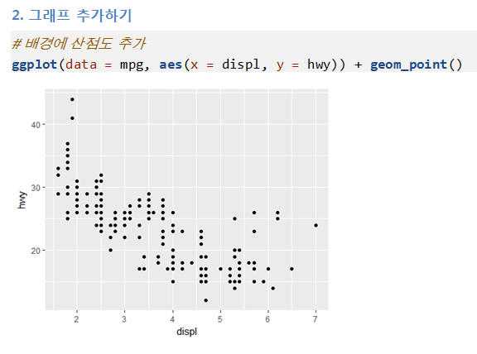

Slide 7
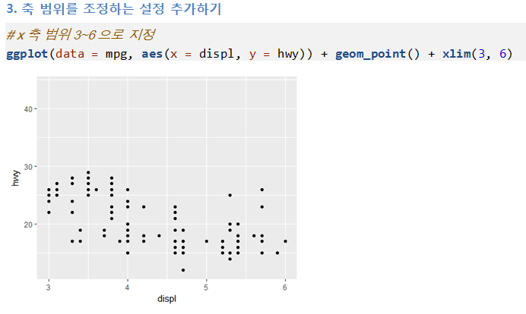

Slide 8
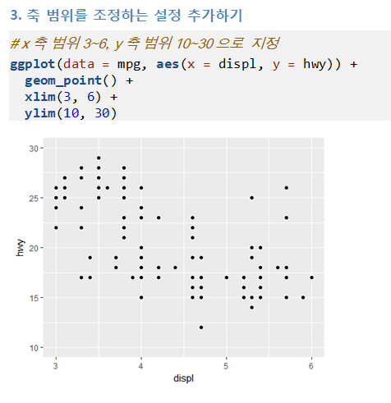

Slide 9
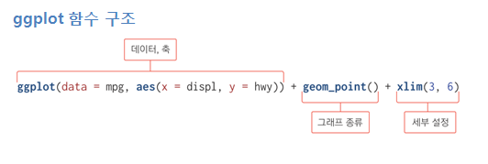
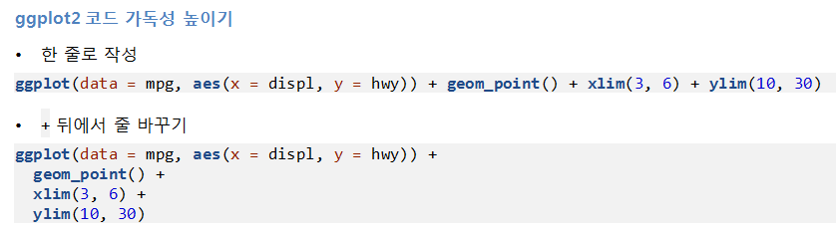


Slide 10
mpg
ggplot(data=mpg,aes(x=displ,y=hwy))
ggplot(data=mpg,aes(x=displ,y=hwy))+geom_point()
ggplot(data=mpg,aes(x=displ,y=hwy))+geom_point()+xlim(3,6)
ggplot(data=mpg,aes(x=displ,y=hwy))+
geom_point()+
xlim(3,6)+
ylim(10,30)

Slide 11
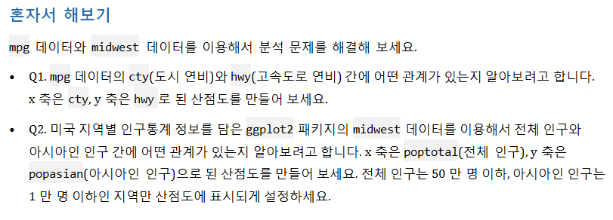



Slide 12
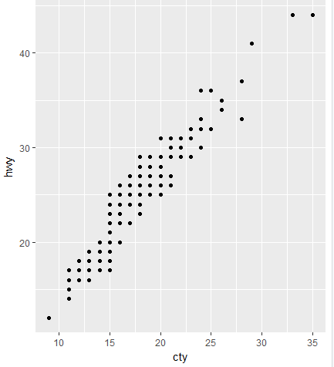
1번문제
ggplot(data=mpg,aes(x=cty,y=hwy))+geom_point()

Slide 13
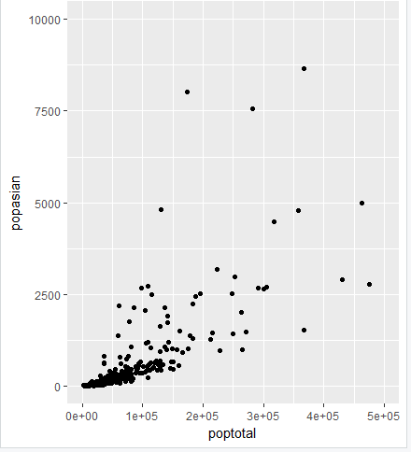
2번문제
ggplot(data=midwest,aes(x=poptotal,y=popasian))+geom_point()+xlim(0,5e+05)+ylim(0,1e+04)

Slide 14

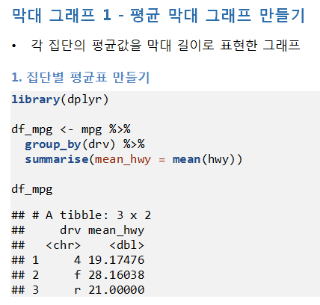

Slide 15
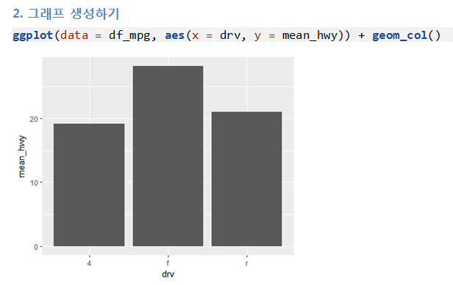
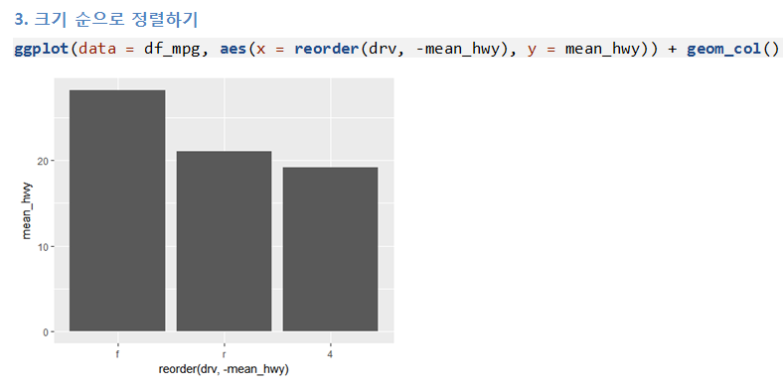

Slide 16
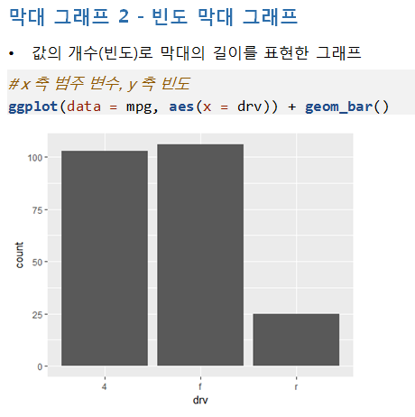

Slide 17
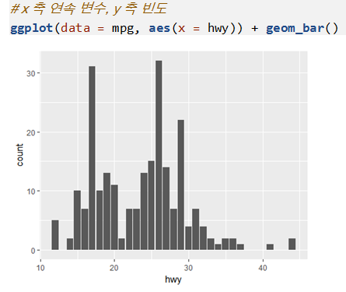
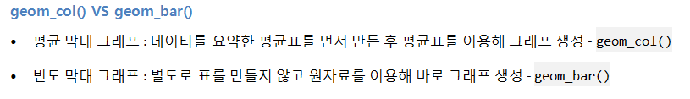

Slide 18
df_mpg<-mpg %>%
group_by(drv) %>%
summarise(mean_hwy=mean(hwy))
df_mpg
ggplot(data=df_mpg, aes(x=drv,y=mean_hwy))+geom_col()
ggplot(data=df_mpg, aes(x=reorder(drv,-mean_hwy),y=mean_hwy))+geom_col()
ggplot(data=mpg,aes(x=drv))+geom_bar()
ggplot(data=mpg,aes(x=hwy))+geom_bar()

Slide 19



Slide 20
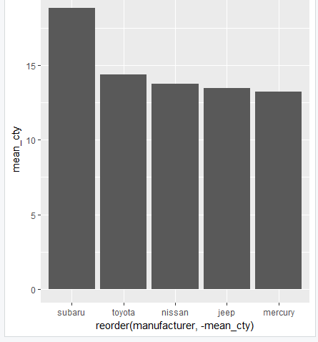
df_mpg<-mpg %>%
filter(class=="suv") %>%
group_by(manufacturer) %>%
summarise(mean_cty=mean(cty)) %>%
arrange(desc(mean_cty)) %>%
head(5)
df_mpg
ggplot(data=df_mpg, aes(x=reorder(manufacturer,-mean_cty),y=mean_cty))+geom_col()

Slide 21
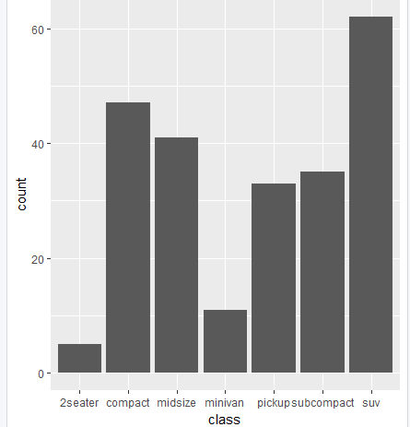
ggplot(data=mpg,aes(x=class))+geom_bar()

Slide 22

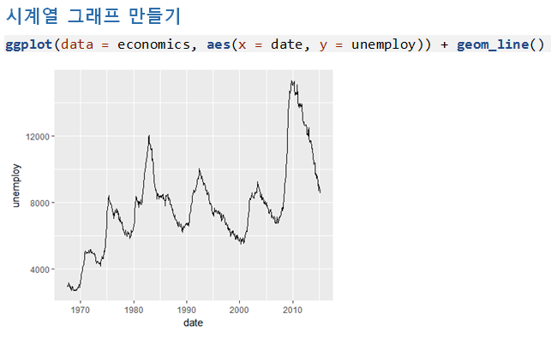

Slide 23
ggplot(data=economics,aes(x=date,y=unemploy))+geom_line()

Slide 24


Slide 25
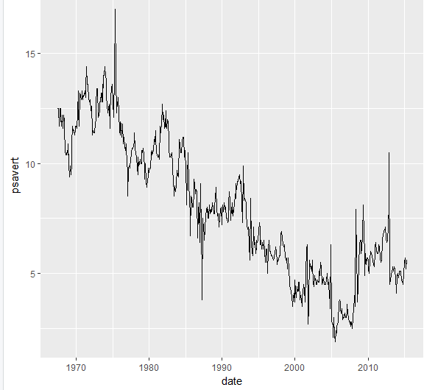
ggplot(data=economics,aes(x=date,y=psavert))+geom_line()

Slide 26

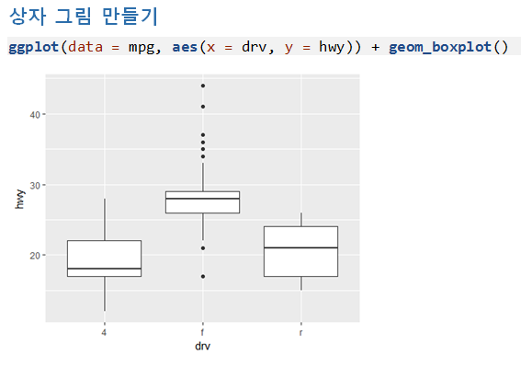
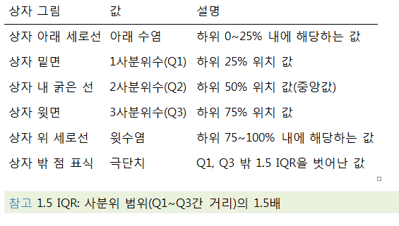
Notes:
ggplot(data=mpg,aes(x=drv,y=hwy))+geom_boxplot()

Slide 27



Slide 28
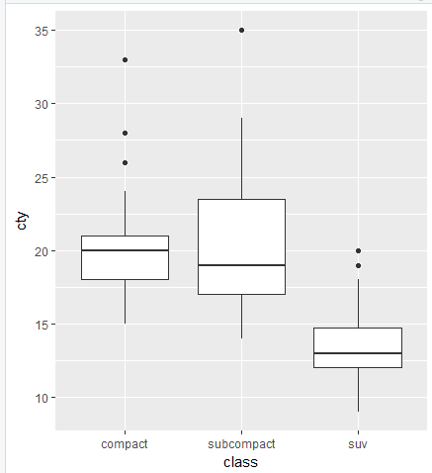
df_mpg<-mpg %>%
filter(class %in% c("compact","subcompact","suv"))
ggplot(data=df_mpg,aes(x=class,y=cty))+geom_boxplot()

Slide 29
